Slide 1
Photomicrographs of Plant Seeds
Fig
Permission to reproduce original photomicrographs used to make this collection may be obtained from
Dr. David O. Norris at
david.norris@colorado.edu

Slide 2
1
2
3
10X
Fig seeds
Notes:
S24. Fig seeds (Ficus carica L.)

Slide 3
2
3
16X
Fig seeds
Notes:
S25. Fig seeds (Ficus carica L.)

Slide 4
1
3
25X
Fig seeds
Notes:
S26. Fig seeds (Ficus carica L.)

Slide 5
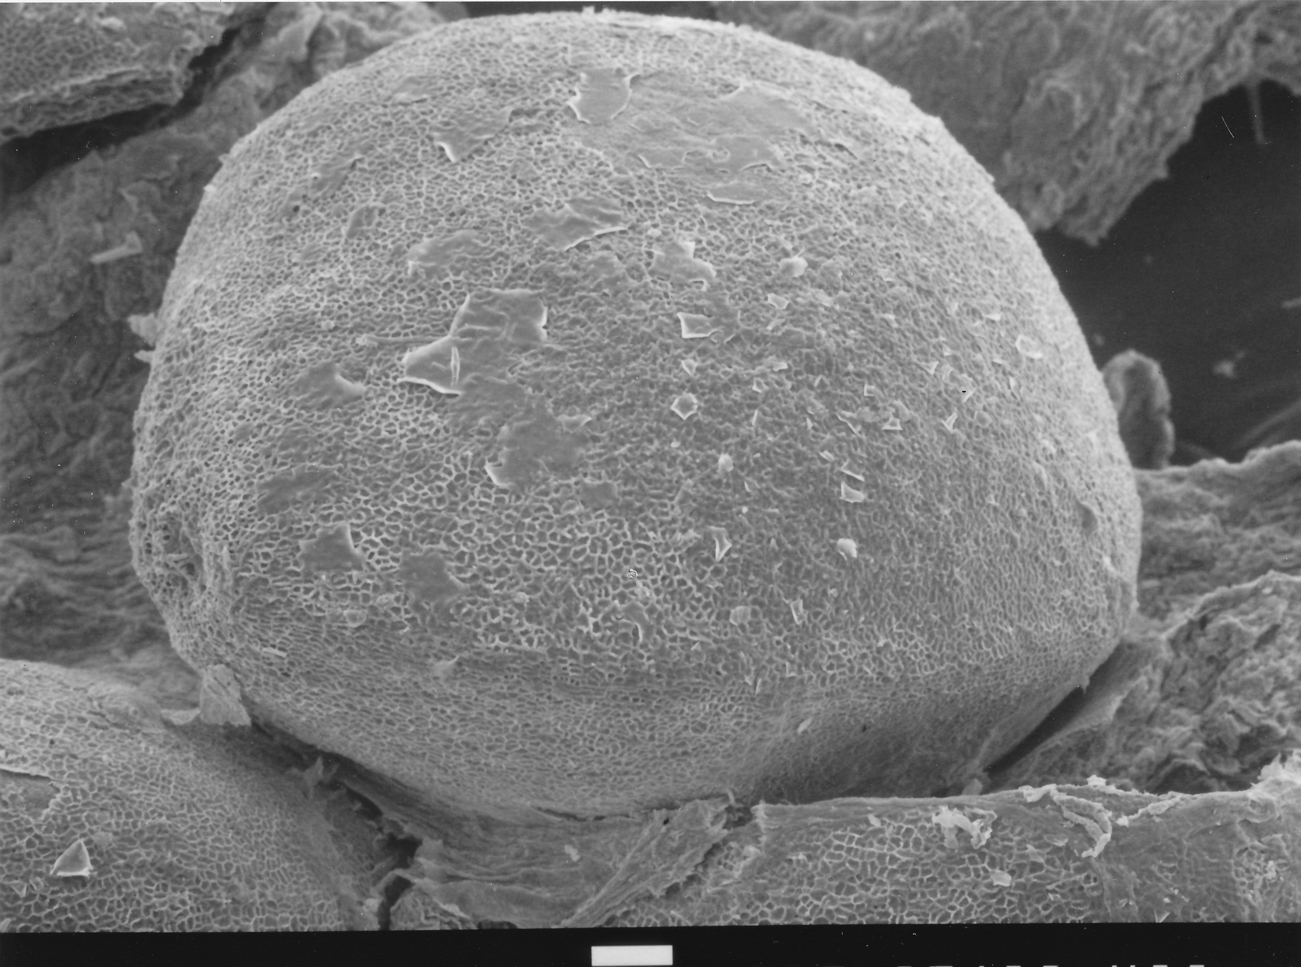
Fig Seed
100 µm
Notes:
S27. Fig seed (Ficus carica L.) SEM. Courtesy of Dr. Meredith A. Lane.

